Slide 1
HANDLING SIGNALS - SHELL SCRIPTING

Slide 2
Controlling Processes with Signals
Sometimes it becomes necessary to alert a process of an event.
We do that by sending a control signal to the process.
Processes may use signals to alert each other as well.
The receiving process halts its execution as soon as it gets the signal and takes an appropriate action as per instructions enclosed in the signal.
The instructions may include terminating the process gracefully, killing it abruptly, or forcing it to re-read its configuration.

Slide 3
Signals are numeric messages sent to running applications from the operating system, other applications or the user, and they generally invoke a specific response like “shut down gracefully”, “stop running so I can put you in the background” or “die!”
Most likely, you've used the kill command to send signals to different programs, but if you've ever pressed Ctrl-C or Ctrl-Z to stop a running app, you've also sent signals to a running application.

Slide 4
# kill –l
A list of available signals can be displayed with the kill command using the –l option.
The output shows the availability of 64 signals for process-to-process and user-to-process communication.
The commands used to pass a signal to a process are kill and pkill. These commands are usually used to terminate a process.

Slide 5
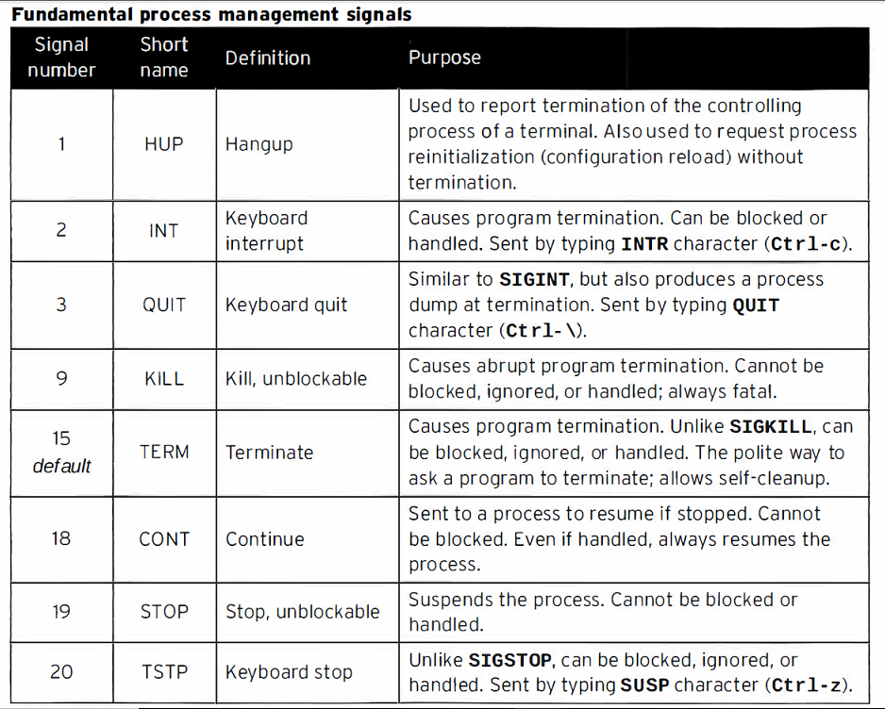

Slide 6
The shell passes these signals to your shell script program for processing.
The default behavior of shell scripts, however, is to ignore the signals, which may have an adverse effect on the operation of your script.
To avoid this situation, you can program your script to recognize signals, and perform commands to prepare the script for the consequences of the signal.

Slide 7
Generating signals
The bash shell allows you to generate two basic Linux signals using key combinations on the keyboard.
This feature comes in handy if you need to stop or pause runaway programs.
Interrupting a process
The Ctrl-C key combination generates a SIGINT signal, and sends it to any processes currently running in the shell. You can test this by running a command that normally takes a long time to finish, and pressing the Ctrl-C key combination:
sleep 100
The Ctrl-C key combination doesn’t produce any output on the monitor, it just stops the current process running in the shell. The sleep command pauses operation for the specified number of seconds.

Slide 8
Trapping signals
The trap command allows you to specify which Linux signals your shell script can watch for and intercept from the shell.
If the script receives a signal listed in the trap command, it prevents it from being processed by the shell, and instead handles it locally.
you want the shell to execute, along with a space-separated list of signals you want to trap. You can specify the signals either by their numeric value or by their signal name.

Slide 9
example of using the trap command to ignore SIGINT and SIGTERM signals:
$ cat test1
#!/bin/bash
# testing output in a background job
trap "echo FINISHED" SIGINT SIGTERM
echo "This is a test program"
count=1
while [ $count -le 10 ]
do
echo "Loop #$count"
sleep 10
count=$[ $count + 1 ]
done
echo "This is the end of the test program"

Slide 10
Trapping a script exit
$ cat test2
#!/bin/bash
# trapping the script exit
trap "echo byebye" EXIT
count=1
while [ $count -le 5 ]
do
echo "Loop #$count"
sleep 3
count=$[ $count + 1 ]
done

Slide 11
Removing a trap
$ cat test3
#!/bin/bash
# removing a set trap
trap "echo byebye" EXIT
count=1
while [ $count -le 5 ]
do
echo "Loop #$count"
sleep 3
count=$[ $count + 1 ]
done
trap - EXIT
echo "I just removed the trap"

